Slide 1
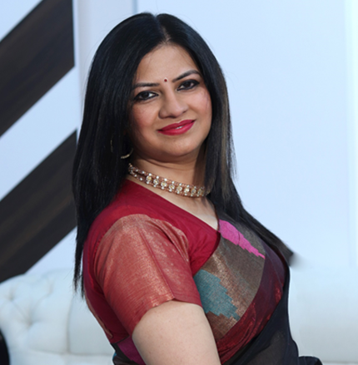
HEMA N
Council Member
BILATERAL COUNCIL OF INDIA -SOUTH KOREA COUNCIL

Slide 2
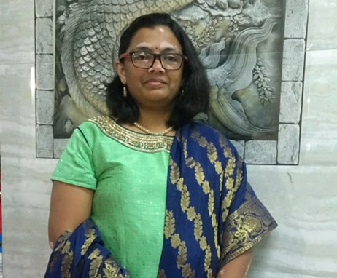
HARSHADA RAVINDRA PRABHUNE
Council Member
BILATERAL COUNCIL OF INDIA -SOUTH KOREA COUNCIL

Slide 3
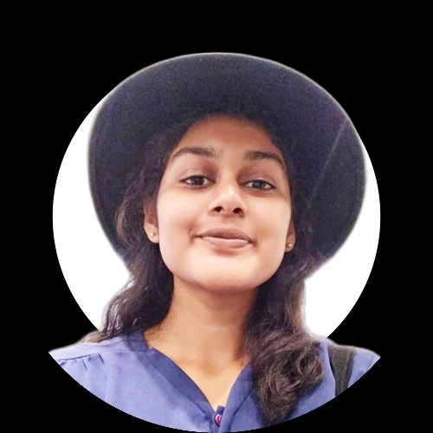
PRATHYUSHA KANCHARANA
Council Member
BILATERAL COUNCIL OF INDIA -SOUTH KOREA COUNCIL

Slide 4
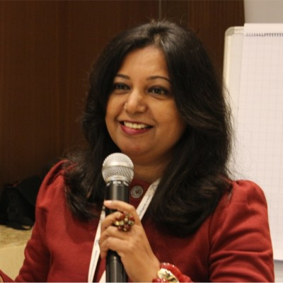
DR. APARNA SETHI
Council Member
BILATERAL COUNCIL OF INDIA -SOUTH KOREA COUNCIL

Slide 5
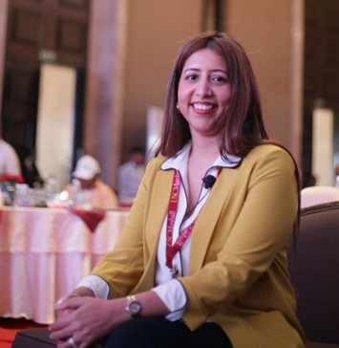
Dr. SHIBANI BELWALKAR
Council Member
BILATERAL COUNCIL OF INDIA -SOUTH KOREA COUNCIL

Slide 6
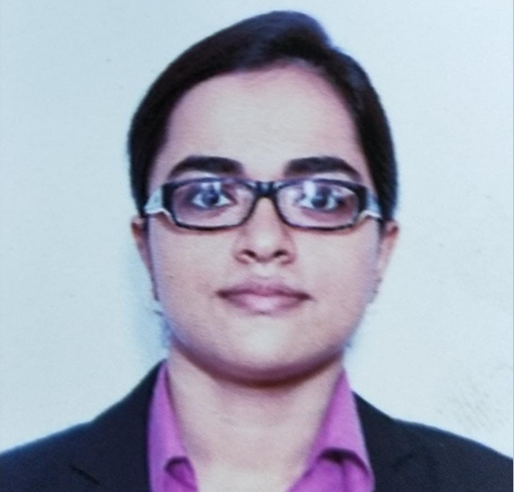
ISHIKA CHATTOPADHYAY
Council Member
BILATERAL COUNCIL OF INDIA -SOUTH KOREA COUNCIL

Slide 7
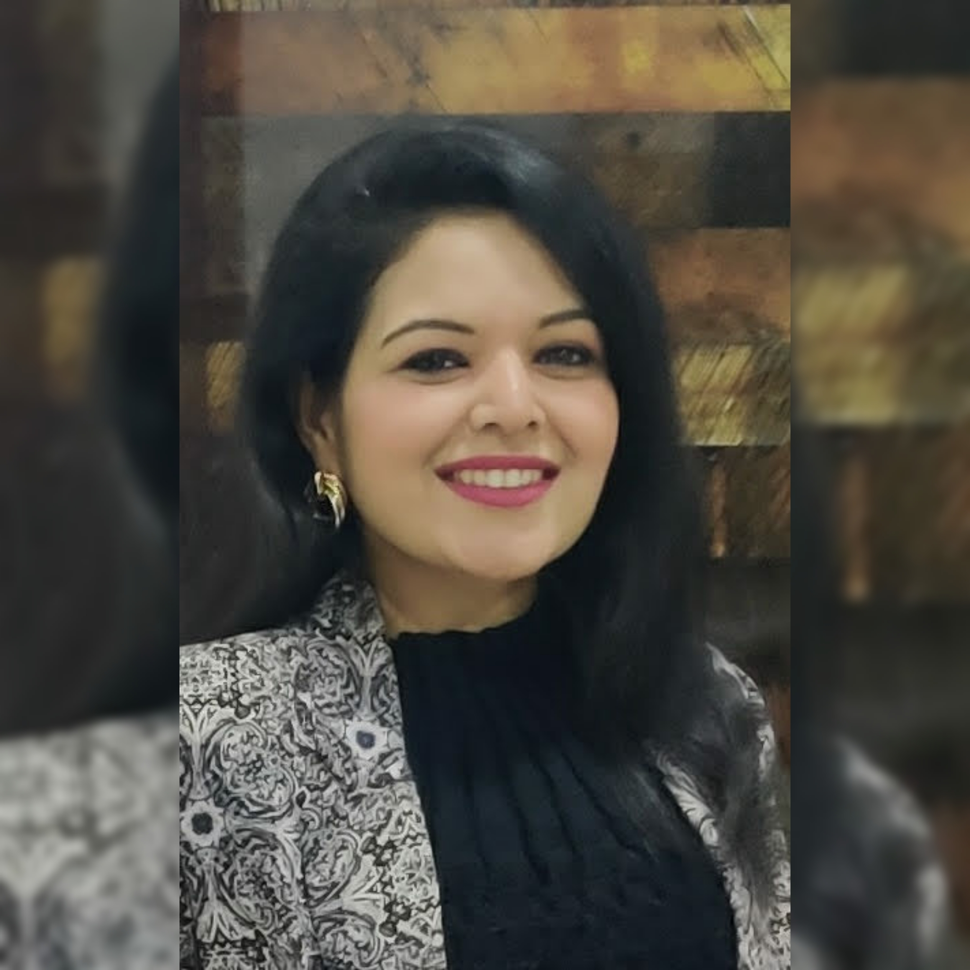
JIGYASA JAIN
Council Member
BILATERAL COUNCIL OF INDIA -SOUTH KOREA COUNCIL

Slide 8
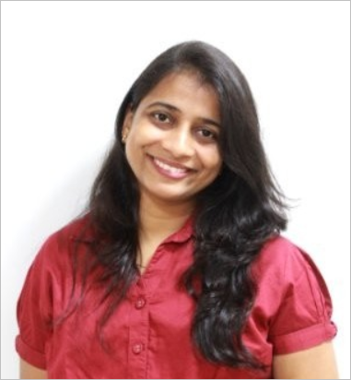
LEENA DIXIT
Council Member
BILATERAL COUNCIL OF INDIA -SOUTH KOREA COUNCIL

Slide 9
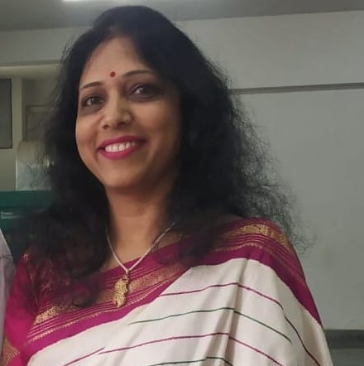
APARNA SRIKANTH
Council Member
BILATERAL COUNCIL OF INDIA -SOUTH KOREA COUNCIL

Slide 10
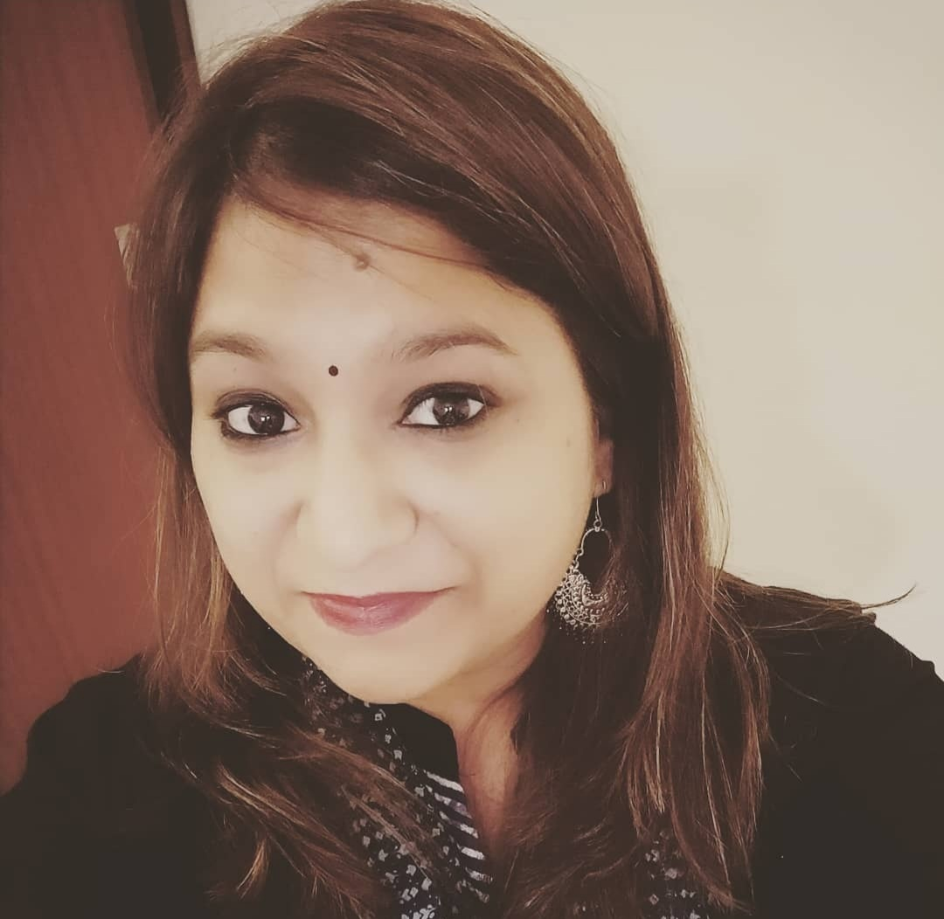
Dr. PRACHI BERIWALA
Council Member
BILATERAL COUNCIL OF INDIA -SOUTH KOREA COUNCIL

Slide 11
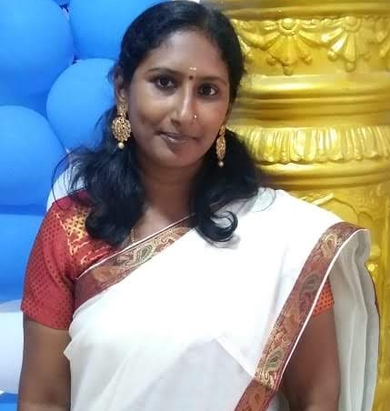
NALINI VASANTHAKUMAR
Council Member
BILATERAL COUNCIL OF INDIA -SOUTH KOREA COUNCIL

Slide 12
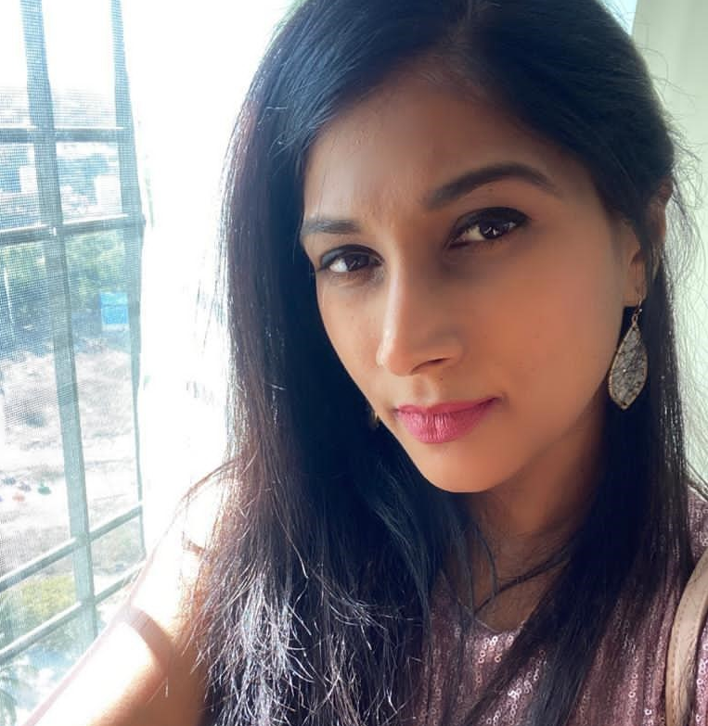
ARPITHA DIWAN
Council Member
BILATERAL COUNCIL OF INDIA -SOUTH KOREA COUNCIL

Slide 13
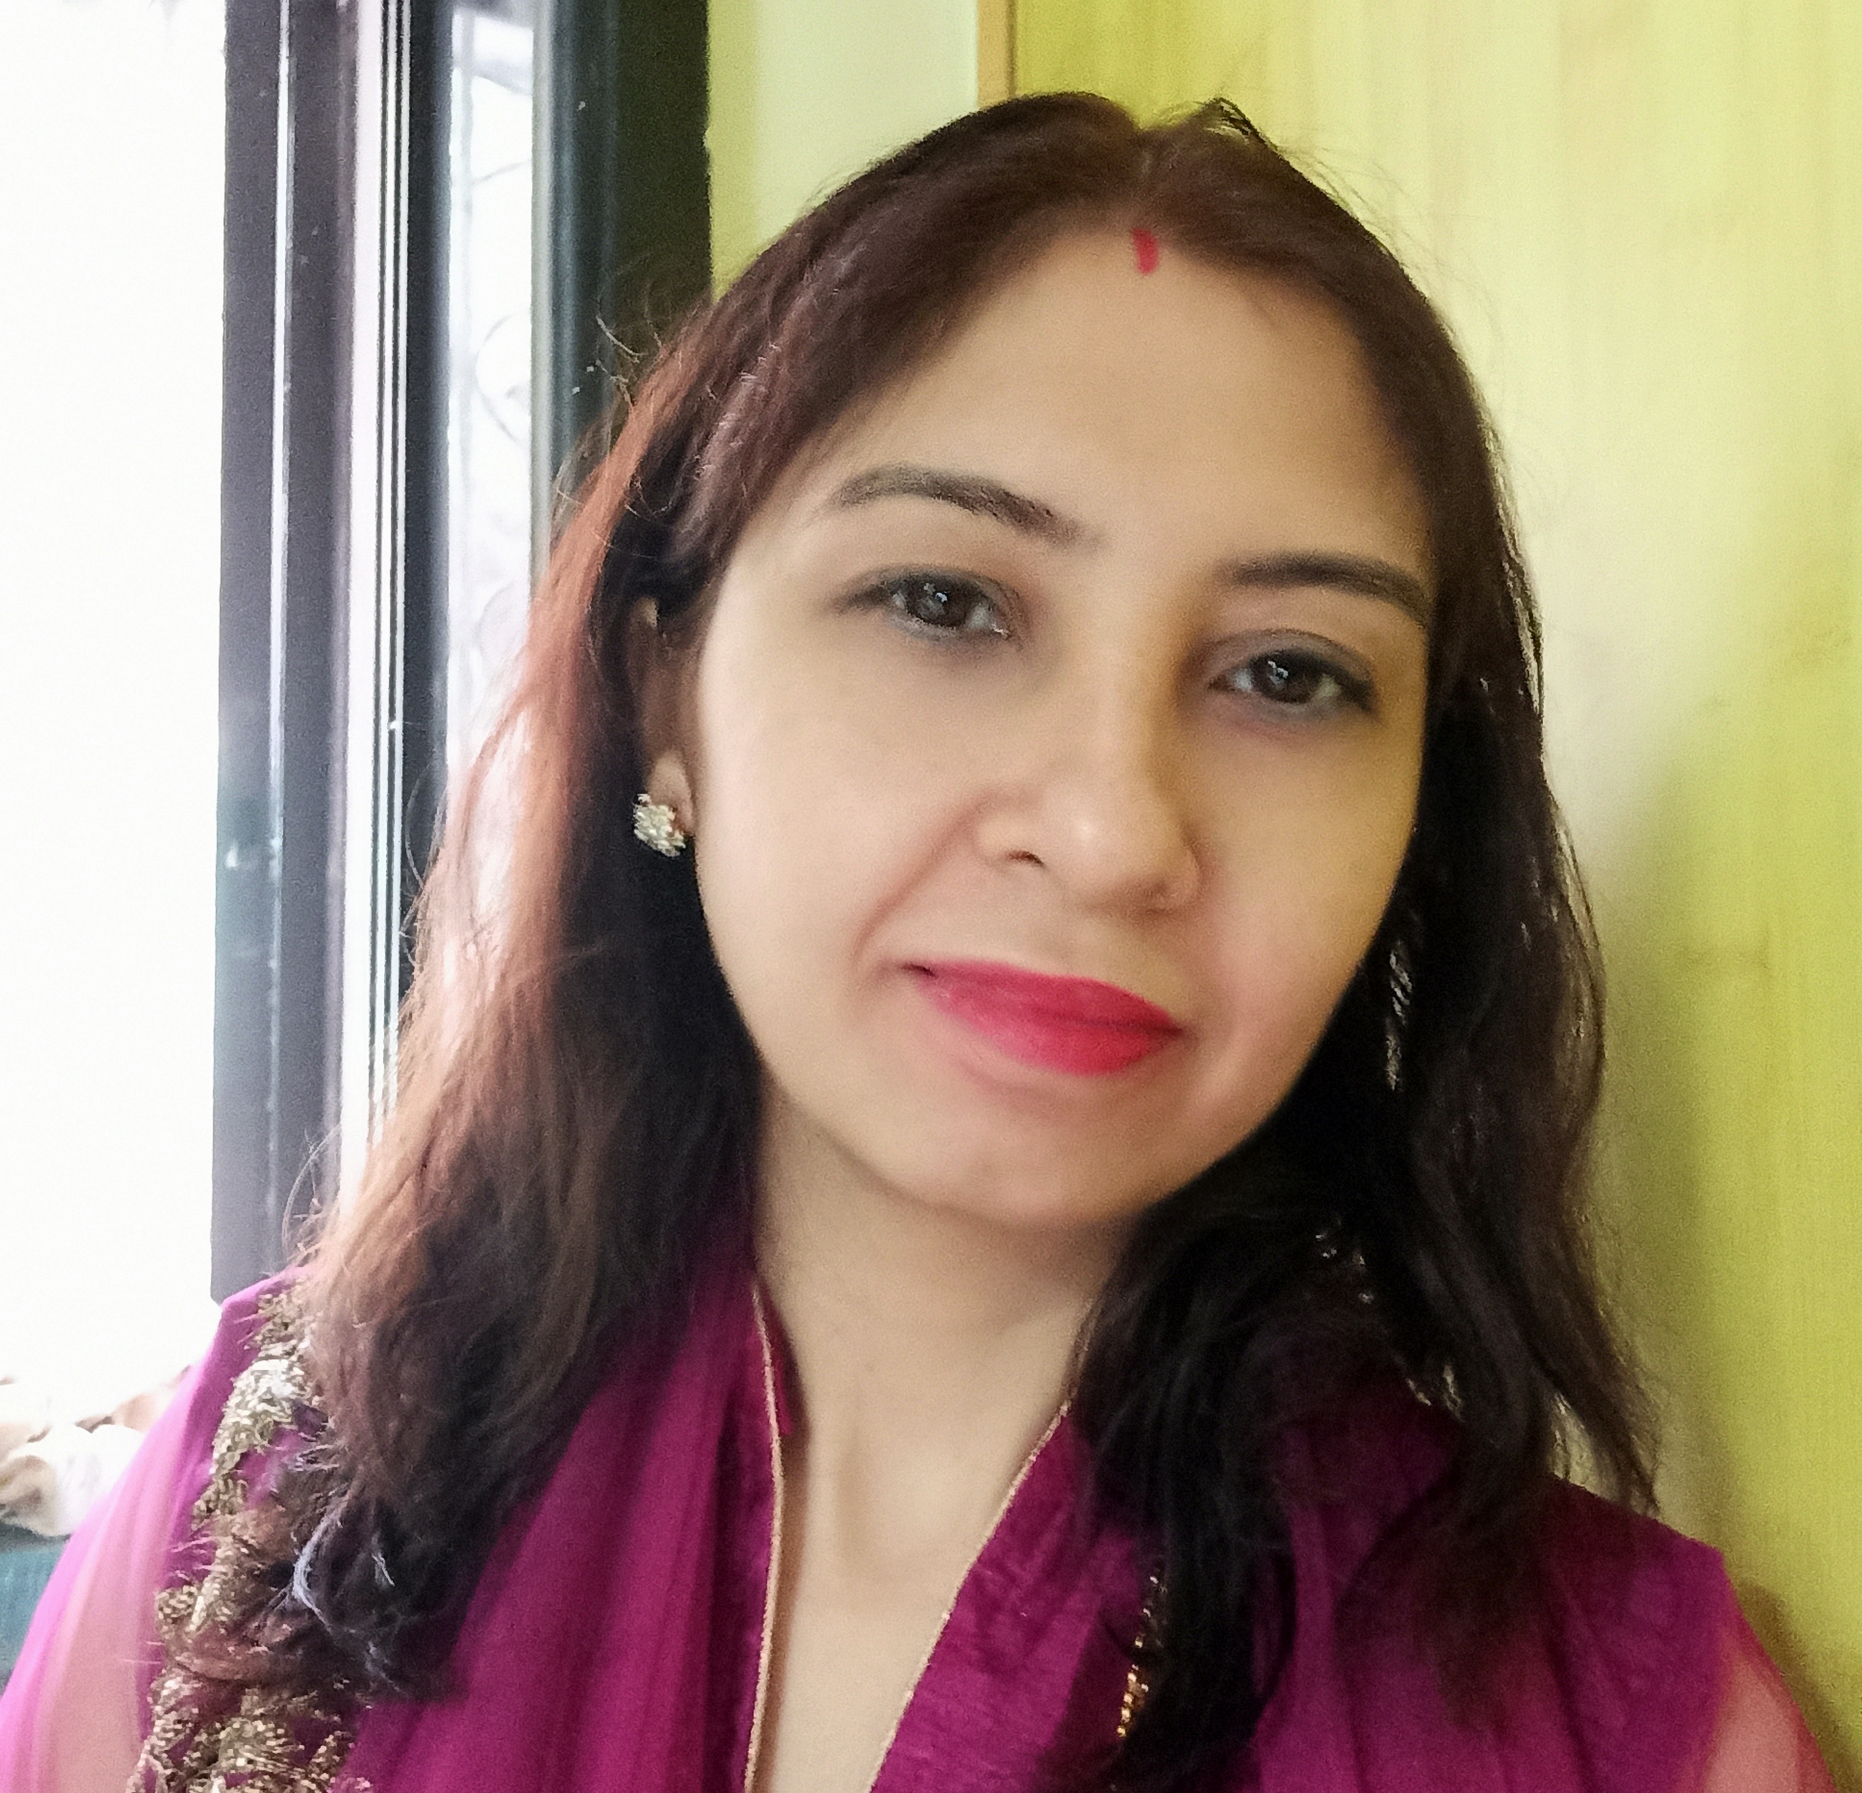
PRIYA MUTHREJA TEJNANI
Council Member
BILATERAL COUNCIL OF INDIA -SOUTH KOREA COUNCIL

Slide 14
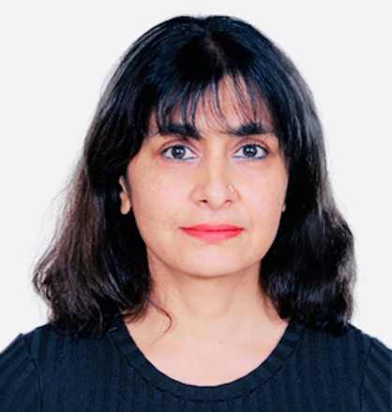
GAYATHRIE MAEDIRATTA
Council Member
BILATERAL COUNCIL OF INDIA -SOUTH KOREA COUNCIL

Slide 15
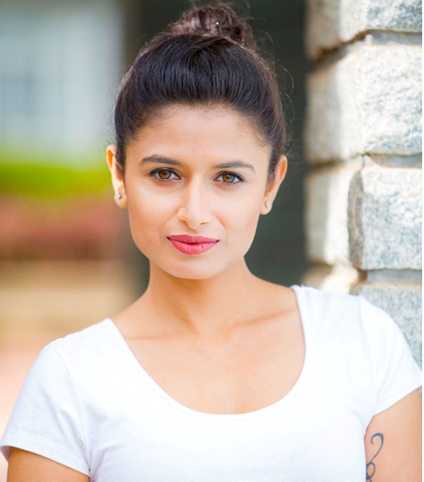
SPOORTI S B
Council Member
BILATERAL COUNCIL OF INDIA -SOUTH KOREA COUNCIL

Slide 16
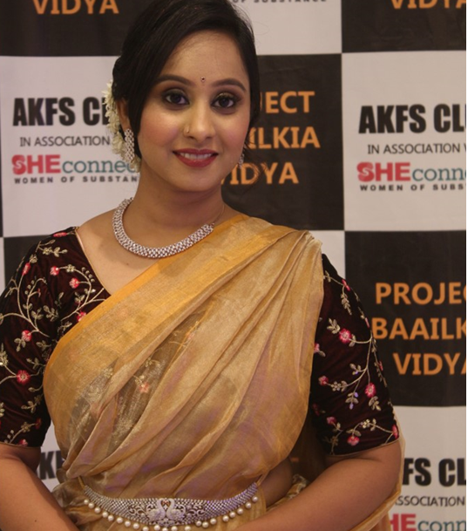
PEEYOOSHA V CHINTALURI
Council Member
BILATERAL COUNCIL OF INDIA -SOUTH KOREA COUNCIL

Slide 17
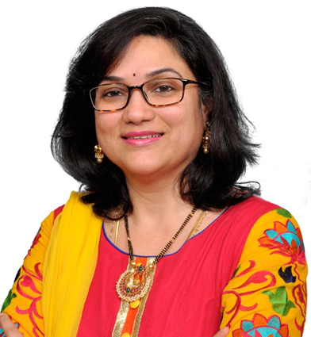
NEERAJA SINGARAJU
Council Member
BILATERAL COUNCIL OF INDIA -SOUTH KOREA COUNCIL

Slide 18
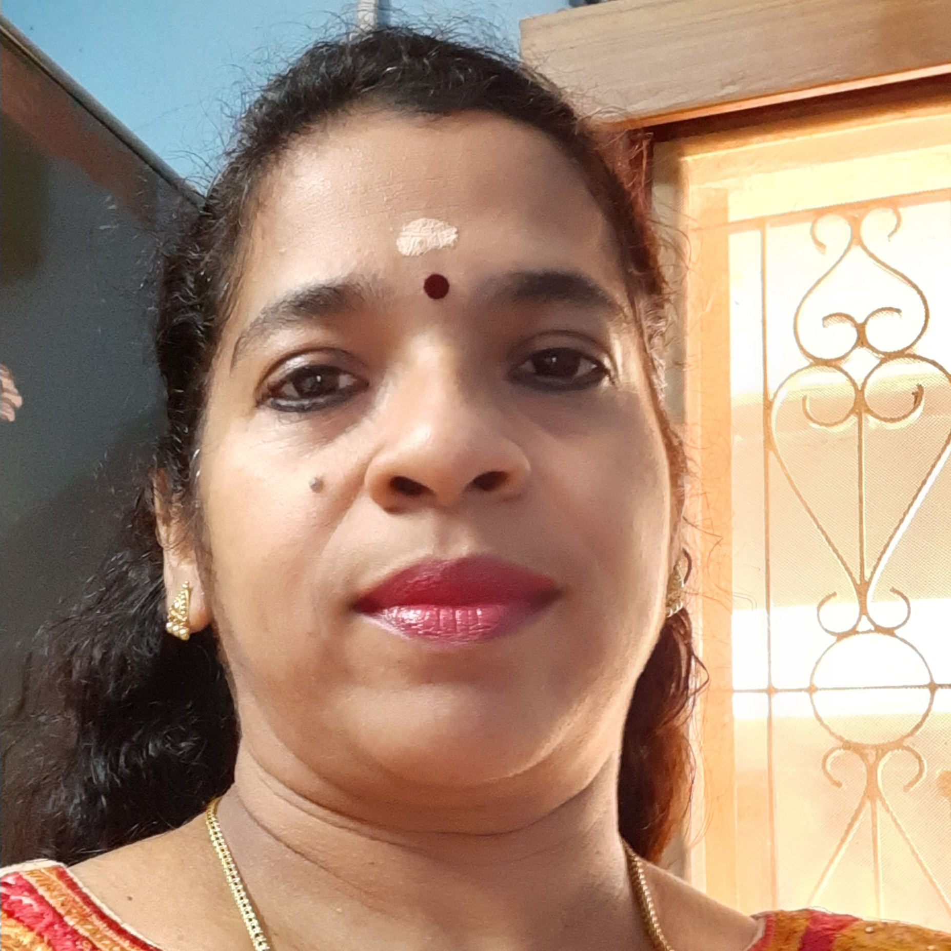
SWAPNA RAMESH
Council Member
BILATERAL COUNCIL OF INDIA -SOUTH KOREA COUNCIL

Slide 19
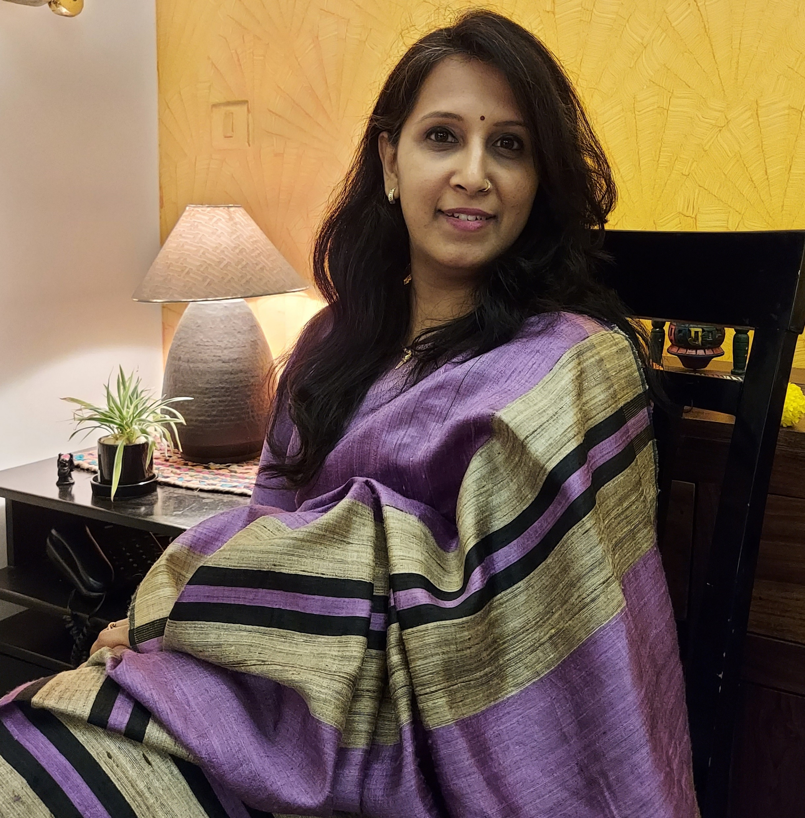
SRIVIDYA SRIDHARAN
Council Member
BILATERAL COUNCIL OF INDIA -SOUTH KOREA COUNCIL

Slide 20
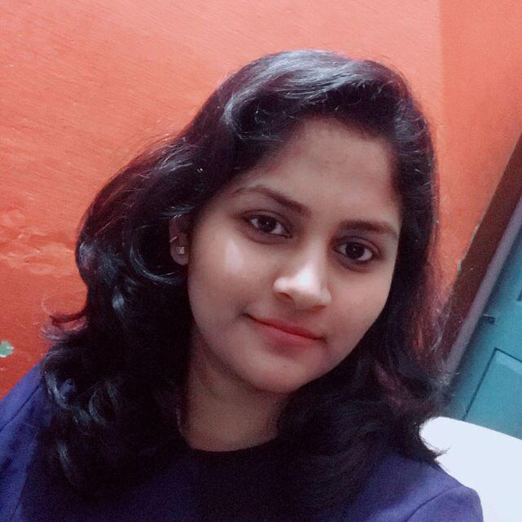
Dr. SPOORTHI N. SAKRI
Council Member
BILATERAL COUNCIL OF INDIA -SOUTH KOREA COUNCIL

Slide 21
<NAME>
Council Member
BILATERAL COUNCIL OF INDIA -SOUTH KOREA COUNCIL

Slide 22
<NAME>
Council Member
BILATERAL COUNCIL OF INDIA -SOUTH KOREA COUNCIL

